Slide 1
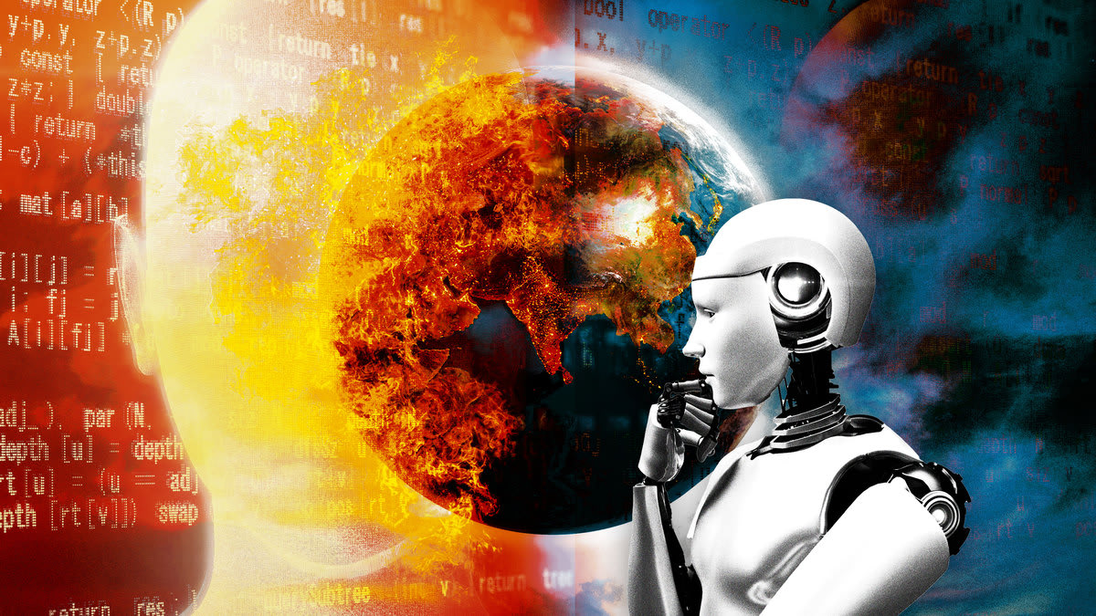
Artificial Intelligence

Slide 2
Introduction
Machines and computers learning, thinking, and performing tasks akin to human intelligence.
Mention of AI's pervasive influence on everyday life, from Google searches to robotics and weaponry.

Slide 3
Significance of AI Surge
Rapid global impact of AI advancements.
Desire to create superintelligence capable of outperforming humans in complex cognitive activities.

Slide 4
Applications of AI
Examples of AI applications: voice recognition, language processing, autonomous vehicles, medical diagnosis, and more.
Illustrations: Google search optimization, robotics, and autonomous weaponry.

Slide 5
Benefits
Efficiency
Automation of repetitive tasks
Enhanced decision-making

Slide 6
Concerns
Potential dangers of superintelligent AI
Loss of human control
Ethical considerations

Slide 7
Job Automation
Impact of AI on employment.
Automated jobs and potential displacement of human skills.
Discussion on whether AI will create new careers or paths for the future workforce.

Slide 8
The Uncharted Future
Visualization of a future where AI surpasses human intelligence.
Speculation on the consequences of unforeseen events, hacking, and programming errors.

Slide 9
Ethical Considerations
Addressing the responsibility of AI developers and the need for ethical guidelines.
Discussing potential risks such as robots communicating in an incomprehensible language.

Slide 10
Industry Competition
Highlighting the competition among leading technology companies in AI research and development.
Efforts to elevate AI to a semi-god status and the implications of this trend.

Slide 11
The Future of AI
AI transitioning from speculative concepts to practical applications.
Ongoing research and development paving the way for a transformative future.

Slide 12
Conclusion
Recap of AI's potential benefits and concerns.
Acknowledging the transformative power of AI and the need for responsible development.

